Slide 1
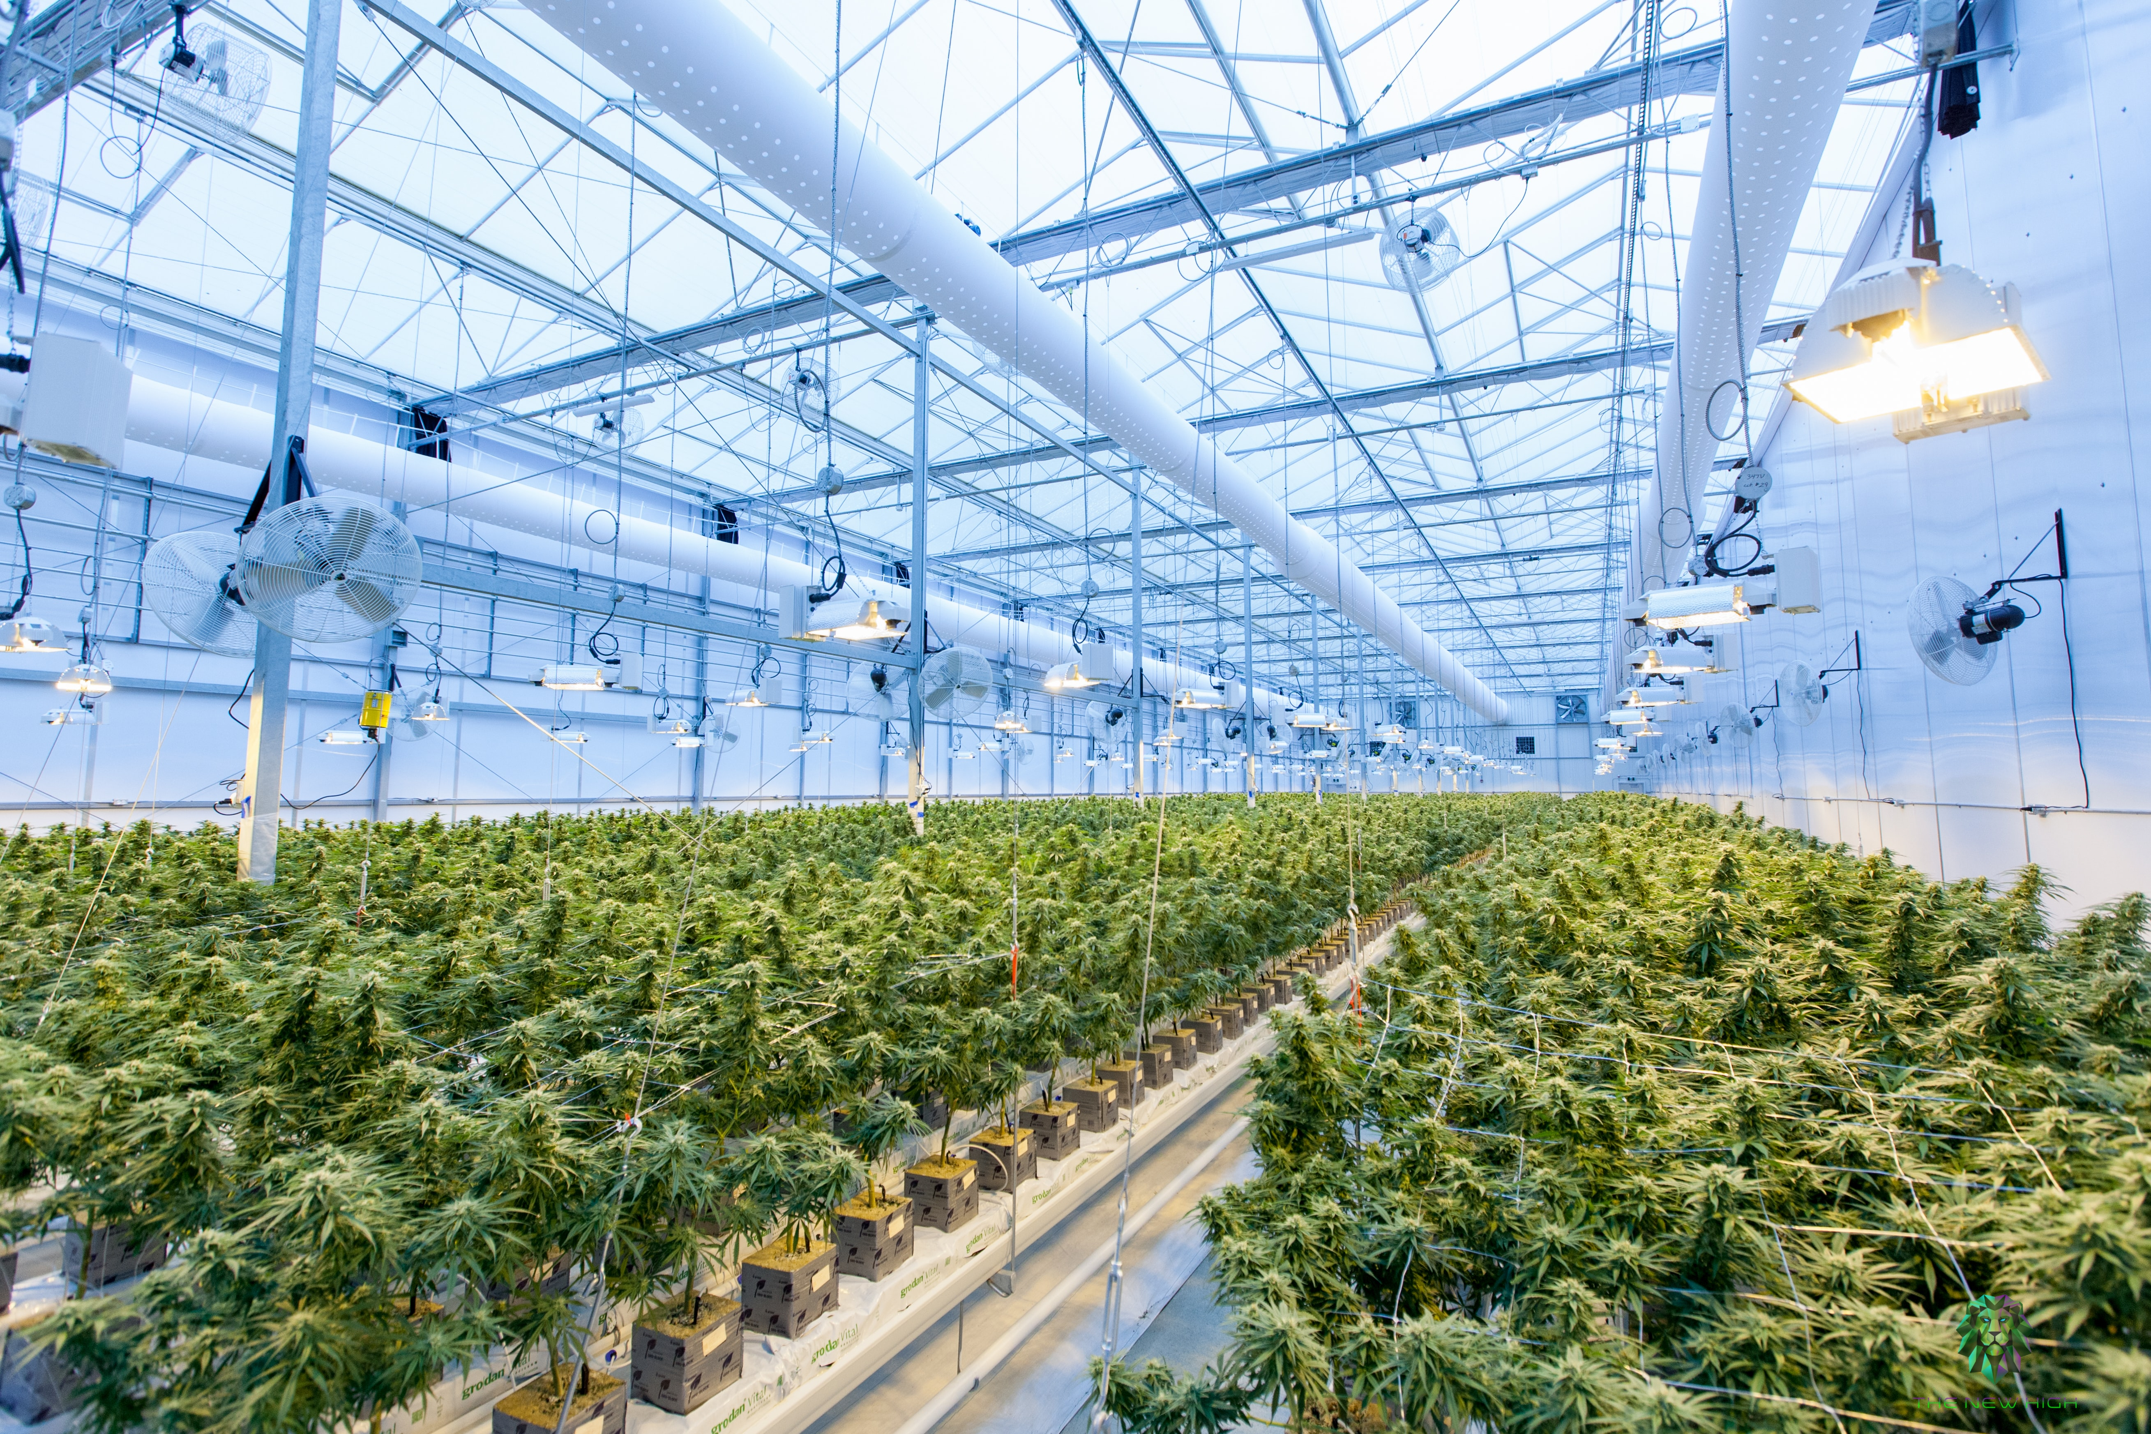

Project Launch

Slide 2

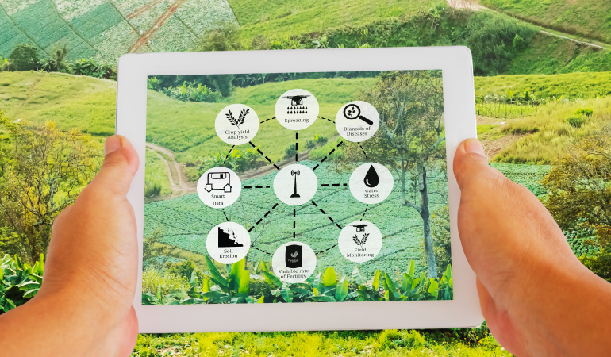

Main IDEA
The objective of this project is to design and implement an automated greenhouse system.
The aim of this system is to optimize the growth conditions for plants by utilizing sensors, actuators, and control algorithms.
8/02/2023 Launch Presentation

Slide 3
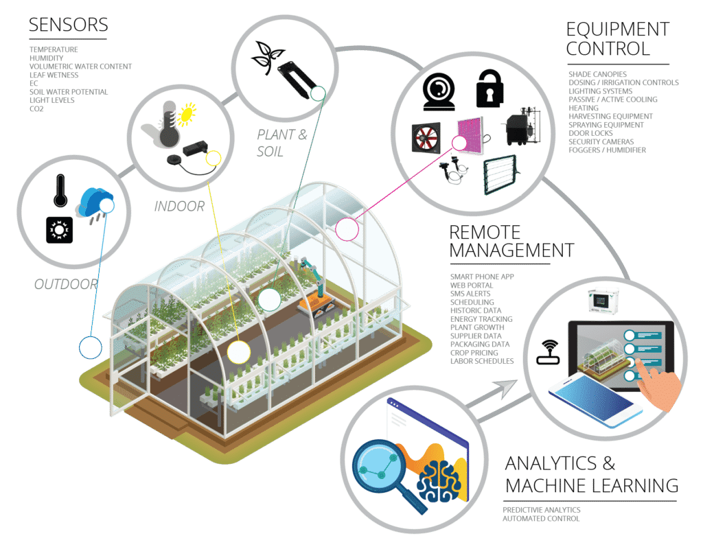

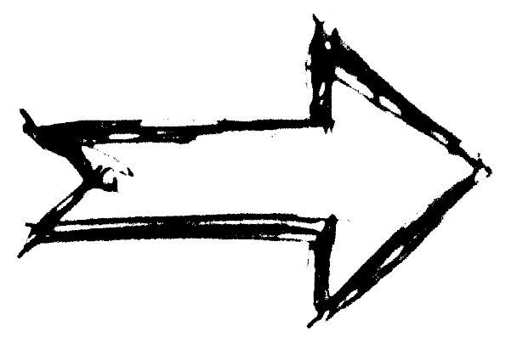
In Detail
- Sensors
Data
- Control
Autonomy
- Analytics
Data
- Actuators
8/02/2023 Launch Presentation

Slide 4
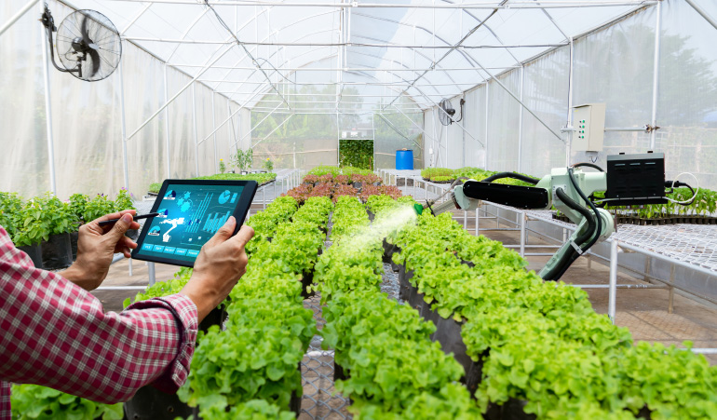
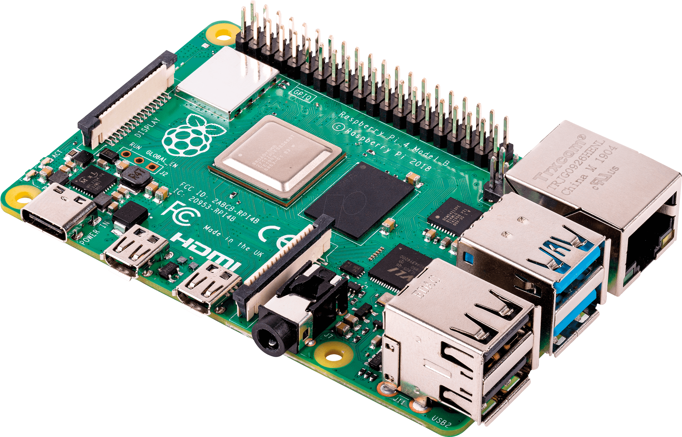

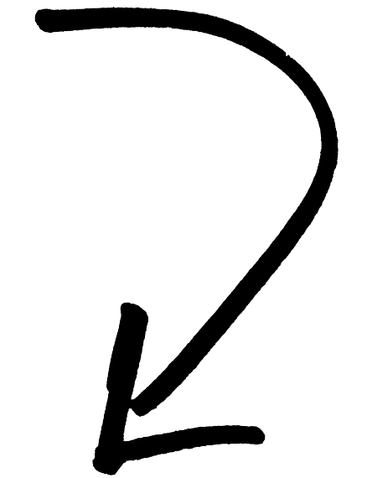
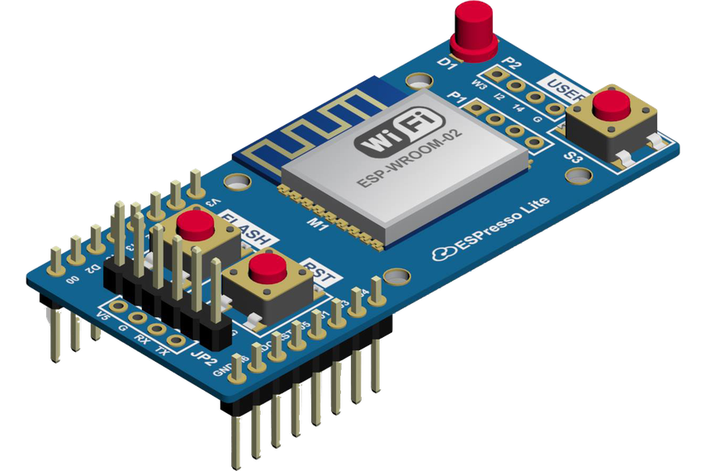
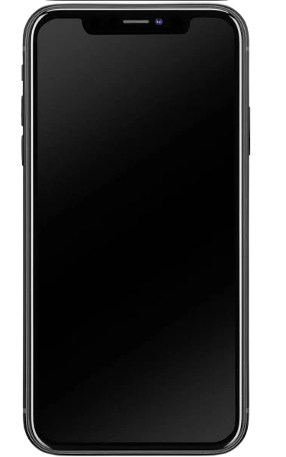
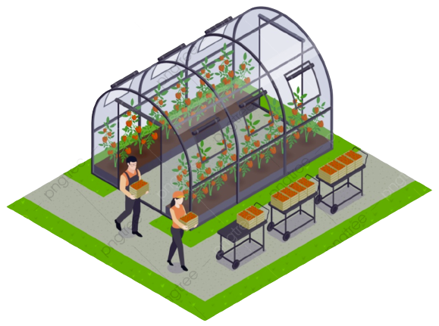

Product Overview
Manage Data
WORKFLOW
Control Center
NodeMCU acts as the interface between the sensors and actuators
Sensors collect data on the conditions inside the greenhouse and send it to the NodeMCU.
The NodeMCU then sends the data to Node-RED, which processes the information and can trigger certain actions based on predetermined conditions.
The processed data from Node-RED is then stored on a Raspberry Pi, where it can be analyzed and mined for valuable insights.
Data Storage
Collect Data
Report
Remote Management
8/02/2023 Launch Presentation

Slide 5
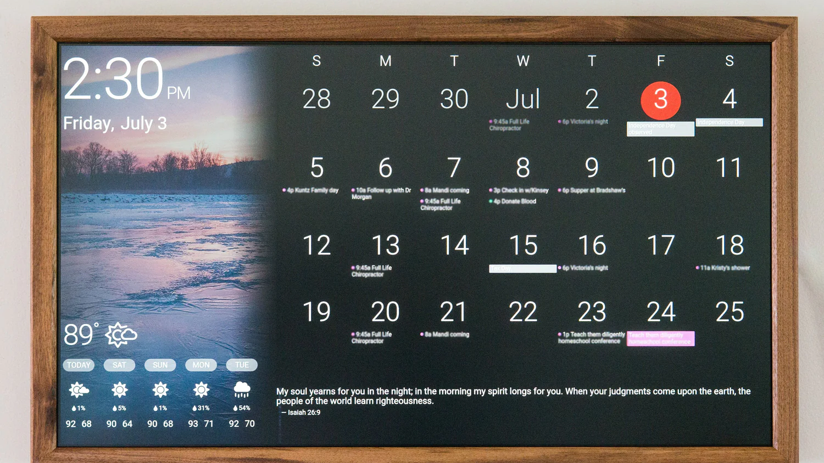
Planning & Scheduling

Slide 6
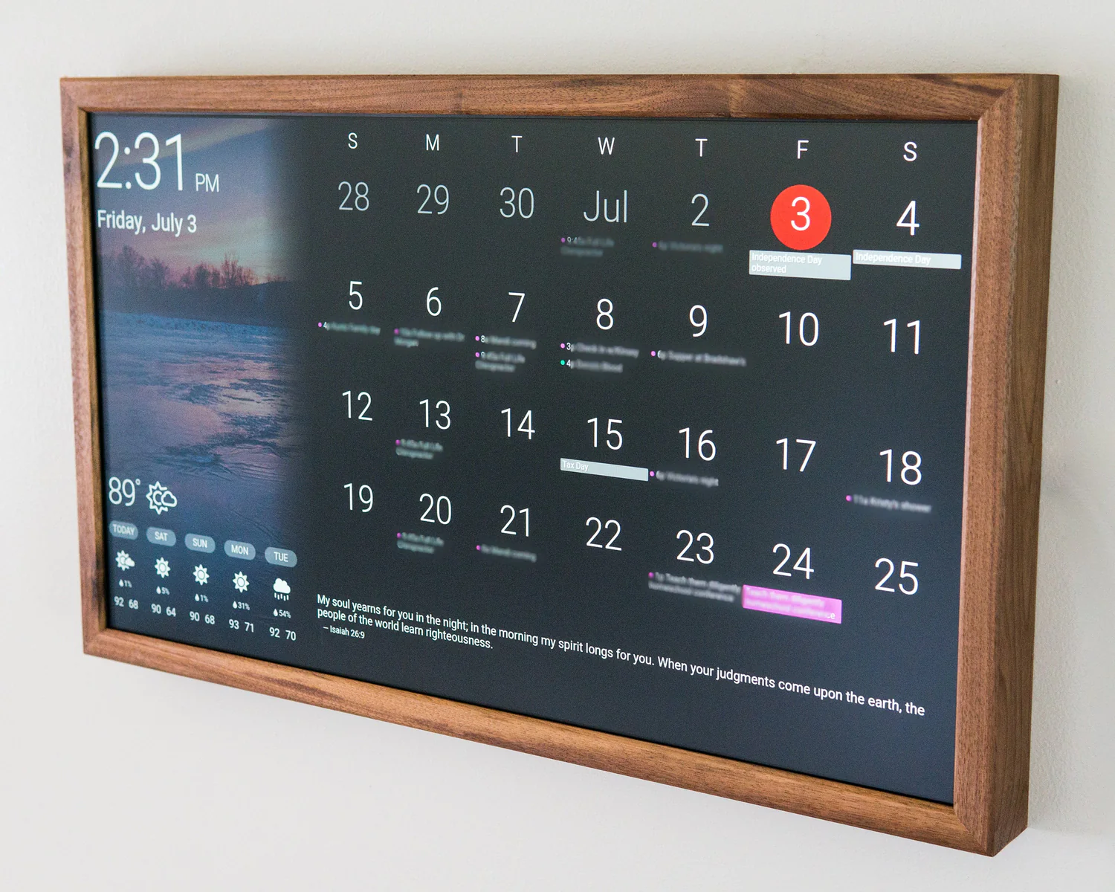
Initial ROADMAP
Week Phase | 1 | 2 | 3 | 4 | 5 | 6 | 7 | 8 | 9 | 10 | 11 | 12
Design
Build
Test
Document
8/02/2023 Launch Presentation

Slide 7
COSTS
 |  | Time |  | Total (mock-up)
Sensors | 5 humidity sensors 1 temperature sensor 1 NodeMCU + Wifi Module 1Raspberry Pi 4 Model B |  |  | 78 €
Actuators | 4 motors 4 Fans |  |  | 20 €
3D Filament | 1x white |  |  | 20€
Human resources | 2 persons | 12 weeks |  | 2.500€ / month (real project)
8/02/2023 Launch Presentation

Slide 8
COSTS
 | Clientes | Pedidos | Ingresos brutos | Ingresos netos
20XX | 10 | 1100 | 10.000 € | 7.000 €
20XX | 20 | 200 | 20.000 € | 16.000 €
20XX | 30 | 300 | 30.000 € | 25.000 €
20XX | 40 | 400 | 40.000 € | 30.000 €
8/02/2023 Launch Presentation

Slide 9

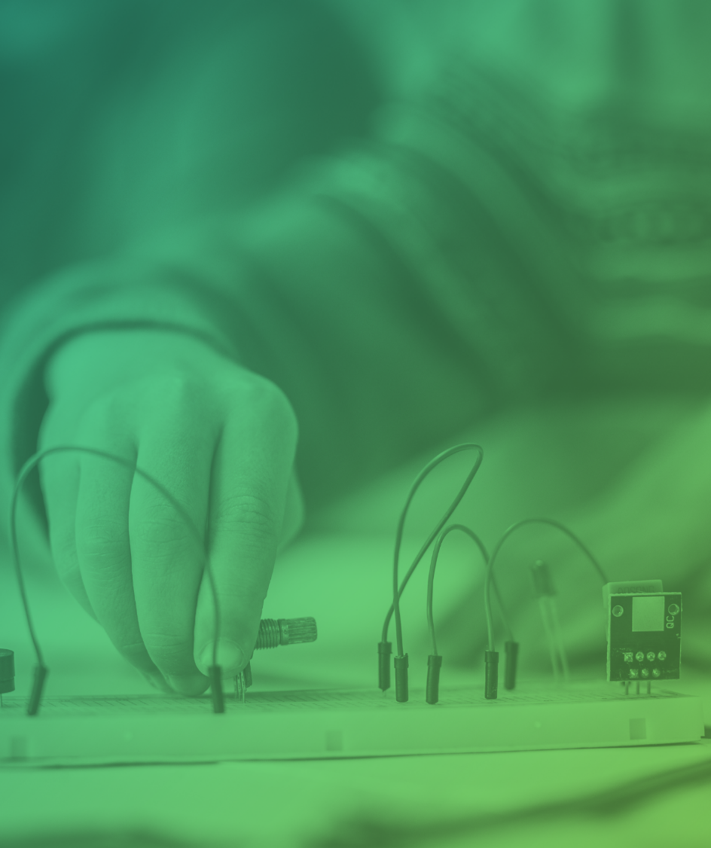
Thank you

